Slide 1
Article Name :
Evolocumab and Clinical Outcomes in Patients
with Cardiovascular Disease
Author: S. Sabatine, P. Giugliano, C. Keech et al
Journal: The new England journal of medicine
Published on: May 2017

Slide 2
Background information
Evolocomb is a human monoclonal that inhibits the enzyme protein convertase subtilisin-kexin type 9(PCSK9)
Evolocomb also lowers low-density lipoprotein (LDL) cholesterol levels by sixty percent
Genetics studies indicates that the carriage of PCSK9 loss-off-function alleles is usually characterized by the reduced risks of myocardial infarction and lower levels of LDL cholesterol
Low-Density lipoproteins (LDL; Bad Cholesterol) carry cholesterol to all cells in the body, including the arteries that supply blood to the heart
Elevations in LDL places a patient at increased risk for atherogenic disease, including coronary, cerebrovascular and peripheral artery disease
With each of these conditions, fatty deposits accumulate in the arteries (atherosclerosis).

Slide 3
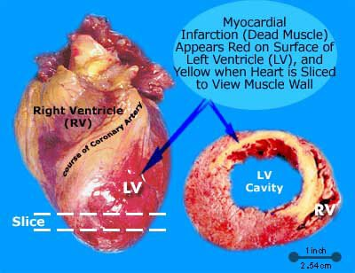
Background information

Slide 4
Management and treatment
  Pharmacologic Treatment
  Statins
    Target: High-Intensity statins 50% reduction in LDL
    4 Statin Benefit Groups
      Clinical ASCVD
      LDL ≥ 190 mg/dL
      LDL 70-189 mg/dL with Diabetes and age 40-75 years
      LDL 70-189 mg/dL and estimated 10-year ASCVD risk ≥7.5%
  Ezetimibe: reduces LDL 18-23%
  Bile Acid Sequestrants/Bile Acid Binding Resins: reduces LDL 10-13%
  Fibrates: reduces LDL 5-20% (but can increase LDL when TG are high)
  Niacin: reduces LDL 5-25%
  Fish Oils: increases LDL 15-44% (No increase LDL with Vascepa) PCSK9 Inhibitors (Evolocumab): reduces LDL by 60%

Slide 5
Non-Drug Treatment
  Lifestyle modification (monitor and reinforce)
    Diet (vegetables, fruits, whole-grain, high-fiber, fish)
    Limit saturated and trans fat, and cholesterol (lean or non-meat alternatives, low-fat dairy)
    Minimize sugars and salt consumption
  Targets
    5-6% calories from saturated fat; decrease percentage of calories from trans fat.
    40 minutes of moderate-to-vigorous intensity aerobic exercise 3-4X/wk (↓ LDL 3-6 mg/dL)
    Maintain healthy BMI 18.5-24.9 kg/m²
Avoid tobacco products, limit alcohol consumption

Slide 6
Evolocumab is PCSK9 inhibitor that lowers LDL-Cholesterol by 60%
the magnitude of benefit of evolocumab in reducing the risk of major coronary events, stroke, and urgent coronary

Slide 7
Objective:
The FOURIER trial tested the clinical efficacy and safety of Evolocumab when added to high-intensity or moderate-intensity statin therapy in patients with clinical ASCVD
Design:
FOURIER trial
Randomized, double-blind, placebo-controlled, multinational clinical trial.
The protocol and amendments were approved by the relevant ethics committees at all participating sites
.

Slide 8
Length of Study
  Randomization from February 2013 through June 2015.
  Median duration of follow-up was 26 months
  All efficacy analysis were conducted on an intention-to-treat basis

Slide 9
Outcomes
  Primary end point: cardiovascular death, myocardial infarction, stroke, hospitalization for unstable angina, or coronary revascularization.
  Key secondary end point: cardiovascular death, myocardial infarction, or stroke.
  Safety was assessed through collection of data on adverse events and central laboratory testing.
  A central clinical-events committee, whose members were unaware of study-group assignments and lipid levels, determined all potential efficacy end-point events and cases of new-onset diabetes.

Slide 10
Interventions
  Run in and wash out period not specified.
  Eligible patients were randomly assigned in a 1:1 ratio to receive subcutaneous injections of:
    Evolocumab or placebo.
    Either 140 mg every 2 weeks or 420 mg every month, according to patient preference.
Monitoring of adherence not specified

Slide 11
Method
Patients at 1242 sites in 49 countries underwent randomization.
Randomization was double-blinded using a central computerized system.
  Stratification according to final screening LDL cholesterol level and region.
  LDL < 85 or ≥85 mg/dL.
Inclusion Criteria
  Age 40-85 years
  Clinical ASCVD
    Myocardial infarction, nonhemorrhagic stroke, or symptomatic peripheral artery disease.
    LDL ≥ 70 mg/dL or HDL ≥ 100 mg/dL while on optimal lipid-lowering therapy (Atorvastatin 20 mg QD or equal)

Slide 12
Exclusion Criteria (ClinicalTrials.gov)
  NYHA class III or IV, or last known LVEF < 30%
  Uncontrolled hypertension
  Uncontrolled or recurrent ventricular tachycardia
  Untreated hyperthyroidism or hypothyroidism
  Homozygous familial hypercholesterolemia
  LDL or plasma ampheresis

Slide 13
Statistical Analysis
90% power to detect a 15% relative risk reduction with Evolocumab as compared with placebo.
  1630 key secondary end points required
Cox proportional-hazards model
  Hazard ratios and 95% confidence intervals.
  Stratification factors as covariates.
Time-to-event analysis
P values for were calculated with the use of log-rank tests.

Slide 14
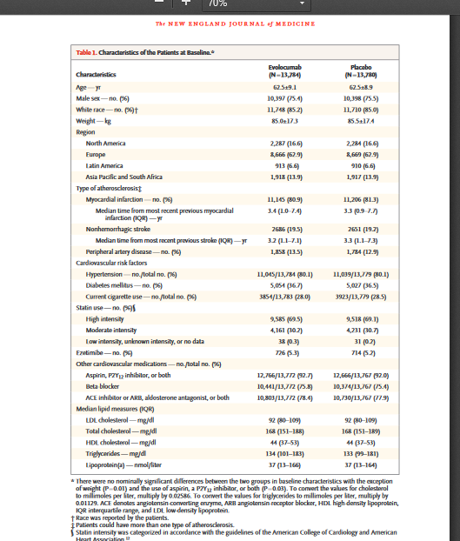
Results

Slide 15
Baseline Characteristics (N=27,564 [Evolocumab N=13,784 and Placebo N=13,780])
  Demographics
    Mean age 63 years, 75% male, 85% white, mean weight 85 kg
  Region
    17% North America, 62% Europe, 7% Latin America, 14% Asian and African
  Type of atherosclerosis (history)
    81% MI, 19% nonhemorrhagic stroke, 13% peripheral artery disease
  Cardiovascular risk factors
    69% hypertension, 37% diabetes mellitus, 28% smokers

Slide 16
  Statin use
    69% high-intensity statin, 30% moderate-intensity statin
  Ezetimibe
    5% on ezetimibe
  Other cardiovascular medications
    92% aspirin, P2Y₁₂ inhibitor, or both, 76% β-blocker, 78% ACEI/ARB, aldosterone antagonist or both
  Median lipid measures
LDL 92 mg/dL, TC 168 mg/dL, HDL 44 mg/dL, TG 134 mg/dL, Lp(a) 37 nmol/L

Slide 17
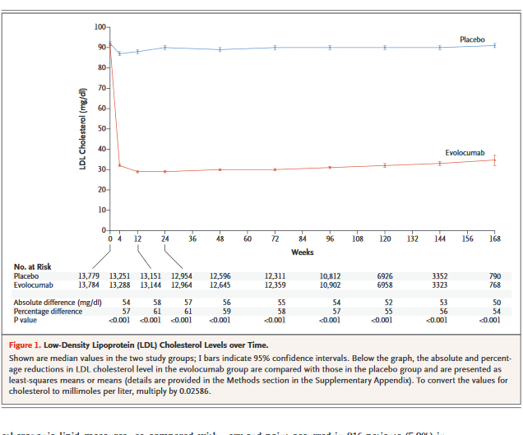

Slide 18
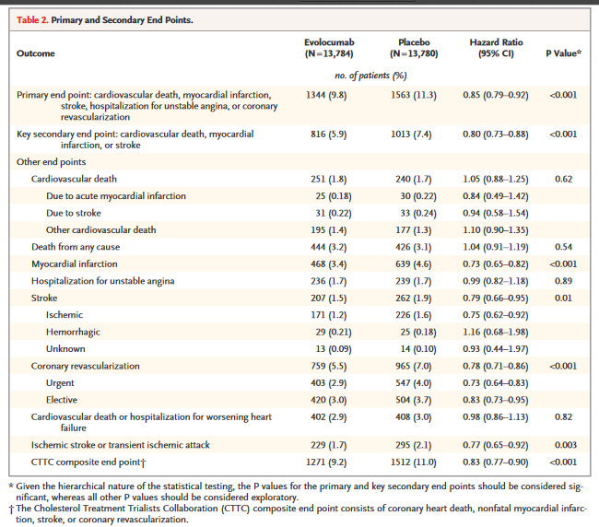
Results
Notes:
Key secondary end point: cardiovascular death, myocardial infarction, or stroke816 (5.9%) vs 1013 (7.4%) [HR 0.80, 95% CI 0.73-0.88, P<0.001]. Primary end point: cardiovascular death,myocardial infarction, stroke, hospitalization for unstable angina, or coronary revascularization.1,344 (9.8%) vs 1563 (11.3%) [HR 0.85, 95% CI 0.79-0.92, P<0.001

Slide 19
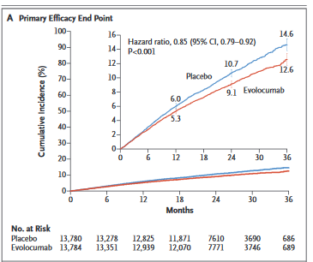

Slide 20
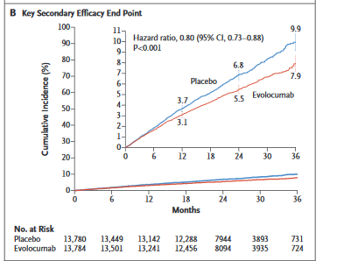
Results

Slide 21
Primary and secondary efficacy endpoint
  Cardiovascular death
  251 (1.8%) vs 240 (1.7%) [HR 1.05, 95% CI 0.88-1.25, P=0.62]
  Death from any cause
  444 (3.2%) vs 426 (3.1%) [HR 1.04, 95% CI 0.91-1.19, P=0.54]
  Myocardial infarction
  468 (3.4%) vs 639 (4.6%) [HR 0.73, 95% CI 0.65-0.82, P<0.001]
  Stroke
  207 (1.5%) vs 262 (1.9%) [HR 0.79, 95% CI 0.66-0.95, P=0.01]

Slide 22
  Coronary revascularization
  759 (5.5%) vs 965 (7%) [HR 0.78, 95% CI 0.71-0.86, P<0.001]
  Cardiovascular death or hospitalization for worsening heart failure
  402 (2.9%) vs 408 (3%) [HR 0.98, 95% CI 0.86-1.13, P=0.82]
  Ischemic stroke or transient ischemic attack
  229 (1.7%) vs 295 (2.1%) [HR 0.77, 95% CI 0.65-0.92, P=0.003]
  CTTC composite end point 1271 (9.2%) vs 1512 (11%) [HR 0.83, 95% CI (0.77-0.90), P<0.001]

Slide 23
Adverse Events
  Any
  10,664 (77.4%) vs 10,644 (77.4%)
  Serious
  3410 (24.8%) vs. 3404 (24.7%)
  Thought to be related to the study agent and leading to discontinuation of study regimen
  226 (1.6%) vs 201 (1.5%)
  Injection-site reaction
  296 (2.1%) vs 219 (1.6%) [p<0.001]
  Allergic reaction
  420 (3.1%) vs 393 (2.9%)

Slide 24
  Muscle-related event
  682 (5.0%) vs 656 (4.8%)
  Rhabdomyolysis
  8 (0.1%) vs 11 (0.1%)
  Cataract
  228 (1.7%) vs 242 (1.8%)
  Adjudicated case of ew-onset diabetes
  677 (8.1%) vs 644 (7.7%)
  Neurocognitive event
  217 (1.6%) vs 202 (1.5%)

Slide 25
Laboratory Test
  Aminotransferase level > 3X ULN
  240 (1.8%) vs 242 (1.8%)
  Creatinine kinase > 5X ULN
  95 (0.7%) vs 99 (0.7%)

Slide 26
Discussion
In this study, 27 564 patients with established atherosclerotic cardiovascular disease and LDL cholesterol levels >_70 mg/dL (1.8 mmol/L) were used as the study population
Despite optimized lipid-lowering therapy(mostly intense statin treatment) were randomized to treatment with evolocumab (a monoclonal antibody inhibiting PCSK9; either 140 mgevery 2 weeks or 420 mg monthly) or matching placebo
A significant 59%reduction in LDL cholesterol levels was observed with evolocumab treat-ment when compared with placebo at 48 weeks from a median LDL cho-lesterol at baseline of 92 mg/dL (2.4 mmol/L) to 30 mg/dL (0.78 mmol/L)
Importantly, during a median follow-up time of 26 months, a significantly
reduced risk of cardiovascular events (in particular myocardial infarctionsand strokes) was observed in patients treated with PCSK9 inhibition

Slide 27
Conclusion
Inhibition of PCSK9 with Evolocumab on a background of statin therapy lowered LDL cholesterol levels to a median of 30 mg/dL and reduced the risk of cardiovascular events. Patients with ASCVD benefit from lowering of LDL cholesterol levels below current targets.
FOURIER trial provided insight into the benefit of decreasing LDL cholesterol levels to median levels lower than those in previous trials.
  PROVE IT-TIMI 22 trial
    Significant reductions in major cardiovascular events.
  TNT trial
    More intensive statin regimen lowered LDL cholesterol levels from 100 mg/dL to 70 mg/dL.
  IMPROVE-IT trial
    Added ezetimibe to statin therapy lowered LDL cholesterol levels from 70 mg/dL to 54 mg/dL and significantly reduced major cardiovascular events.
  4S
    FOURIER rates of mortality were one third of 4S.
  SEARCH
Similar to FOURIER, no effect on hospitalization for unstable angina.

Slide 28
Article Critique
Strengths
  Appropriate dosage and treatment interventions
  Adequate blinding
  Adequate inclusion and exclusion criteria
  Baseline characteristics were nearly identical
    Strengthens internal validity
  Data was presented clearly
  Compared results with other studies to support author’s conclusion
  Appropriate use of statistics

Slide 29
Limitations
  Short duration of follow-up
    Limits evaluation of long term benefits of Evolocumab.
  Underpowered to detect a mortality benefit with Evolocumab Due to low cardiovascular mortality rates.
  Potential for bias due to manufacturer/sponsor (Amgen) of Evolocumab (Rapatha).
  Baseline characteristics were slightly skewed. (Mostly male and white)Weakens external validity

Slide 30
THANK YOU

